Slide 1
Farm Management System
Afifa Nowreen Akhter
UG02-47-18-023

Slide 2
Introduction
The ‘Farm Management System’ has been developed to override the problems prevailing in the practicing manual system. This is designed to assist in strategic planning, and will help you ensure that your organization is equipped with the right level of information and details for your future goal.

Slide 3
Abstract
The main objective of the project is to manage the details of farm. The project is totally build at administrative end and thus only the administrator is guaranteed the access. The purpose of the project is to build an application program to reduce the manual work for managing the farm, crops, cost range.

Slide 4
Functionalities
Shows information of crops, cost range etc.
Shows description of crops, cost range etc.
It deals with monitoring the information and transaction of the products.
Editing, adding and updating of records is improved which results in proper resource management of farm data.

Slide 5
Features
Product and component based.
It contains better storage capacity.
Accuracy in work.
Access of any information individually.
Work becomes very speedy.
Easy to update information.

Slide 6
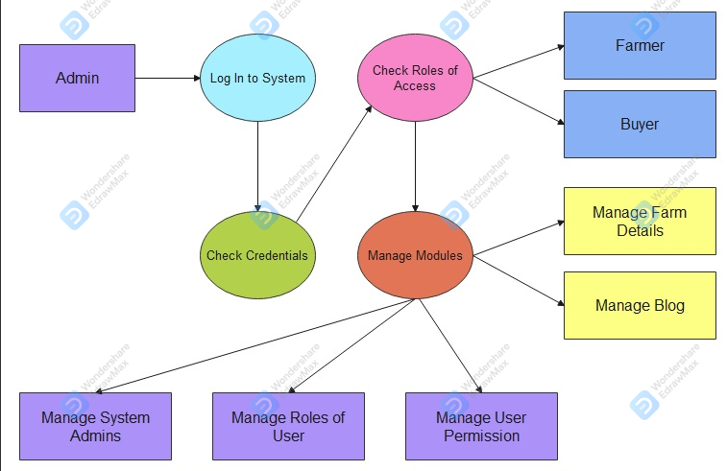
ER Diagram

Slide 7

Home Page

Slide 8
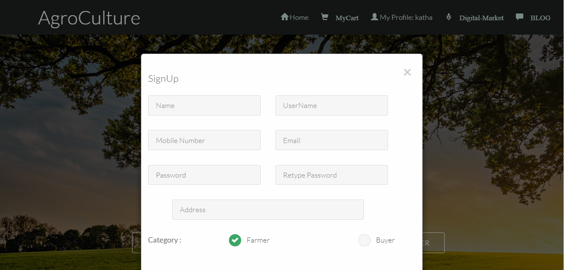
Home Page REGISTER

Slide 9
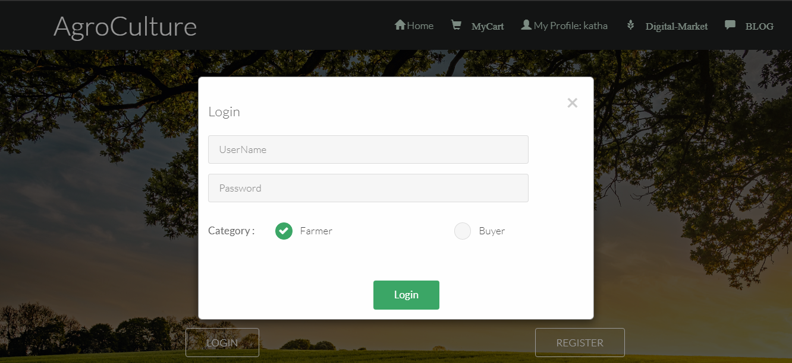
Home Page LOGIN

Slide 10
Requirement
HTML
PHP
CSS
Bootstrap
JavaScript
MySQL

Slide 11
Supported Operating System
Windows
Linux
Mac

Slide 12
Future Work
We can give more advance software for farm management system including more facilities.
We will host the platform on online servers to make accessible worldwide.
Implement the backup mechanism for taking backup of codebase and database on regular basis on different servers.

Slide 13
Conclusion
Farm management system can lead to error free, secure, reliable and fast management system.
It can assist the user to concentrate on their other activities rather to concentrate on record keeping.
Thus it will help organization in better utilization of resources.

